Slide 1
Soils: What Lies Beneath?
Megan Taylor

Slide 2

Your Local Extension Agronomist

Slide 3

More Resources and Information

Slide 4
Question 1
What is CEC?
A) Calculated electrical charge
B) Corrected evapotranspiration calculation
C) Cation exchange capacity
D) Clowns executing cartwheels!

Slide 5
Question 2
How many sub-samples of soil should I take for my garden?
A) 4 sub-samples
B) 20 sub-samples
C) 12 sub-samples
D) 15 sub-samples

Slide 6
Question 3
Soil ribboning tells me what about the soil?
A) The soil order
B) The CEC
C) The soil texture
D) The parent material

Slide 7
Question 4
Rate the soils for water holding capacity from best to worst.
A) sandy, clay, and silty
B) silty, clay, and sandy
C) clay, silty, and sandy
D) silty, sandy, and clay

Slide 8
Question 5
What is one way I can stop erosion at my home?
A) apply mulch to loose areas
B) nothing erosion will happen regardless
C) plant grass, a perennial, or cover crop
D) plant an annual on severe slopes
E) all but B

Slide 9
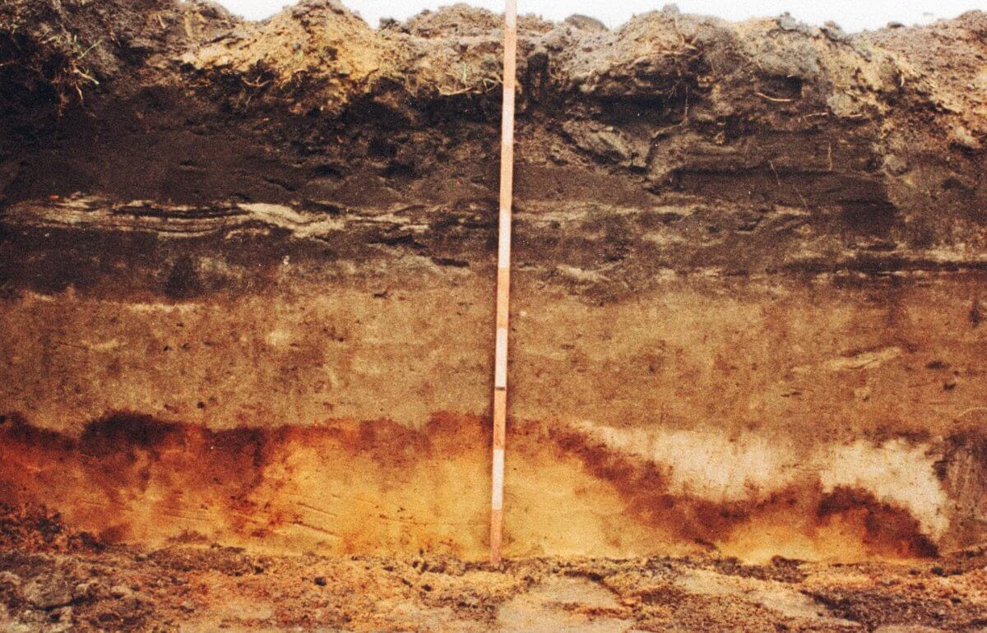
What will I learn?
Soils 101: the who, what, where, and when!
Soils and Water
Explore your soils: sampling, testing, and CEC oh my!
Cover Crops to improve soil health

Slide 10


Soils 101: Horizons
O
A
B
C
R

Slide 11
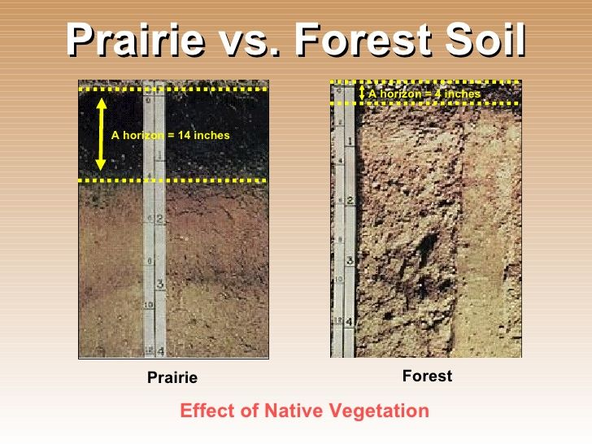
Soils 101: Formation
5 formation factors
Native Vegetation
Time
Topography
Climate
Parent material

Slide 12
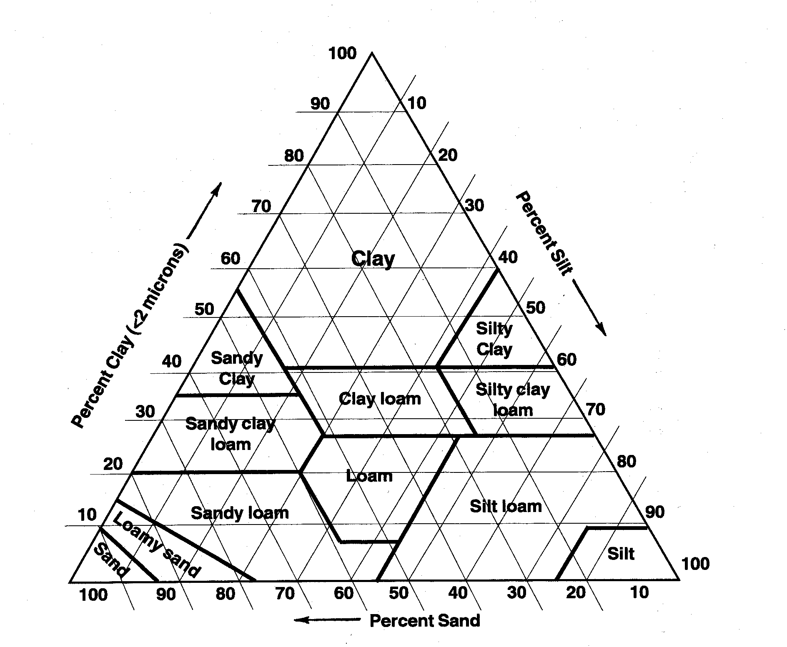
Soils 101: Components
CLAY
SILT
SAND

Slide 13
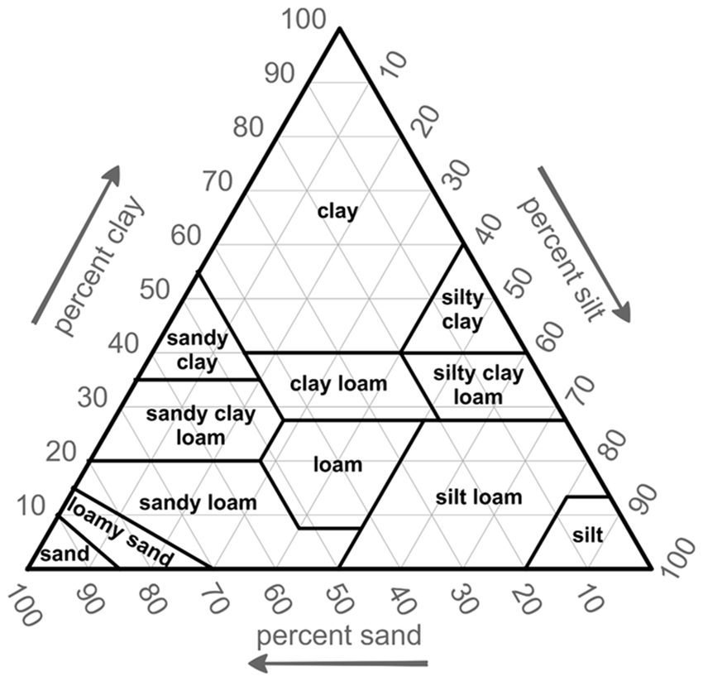
Components and Ribboning
Will hold together and make ribbon
Has the consistency of flour
Gritty pieces, does not hold shape

Slide 14
Components and Ribboning: Let’s Try It!!
Will hold together and make ribbon
Has the consistency of flour
Gritty pieces, does not hold shape

Slide 15
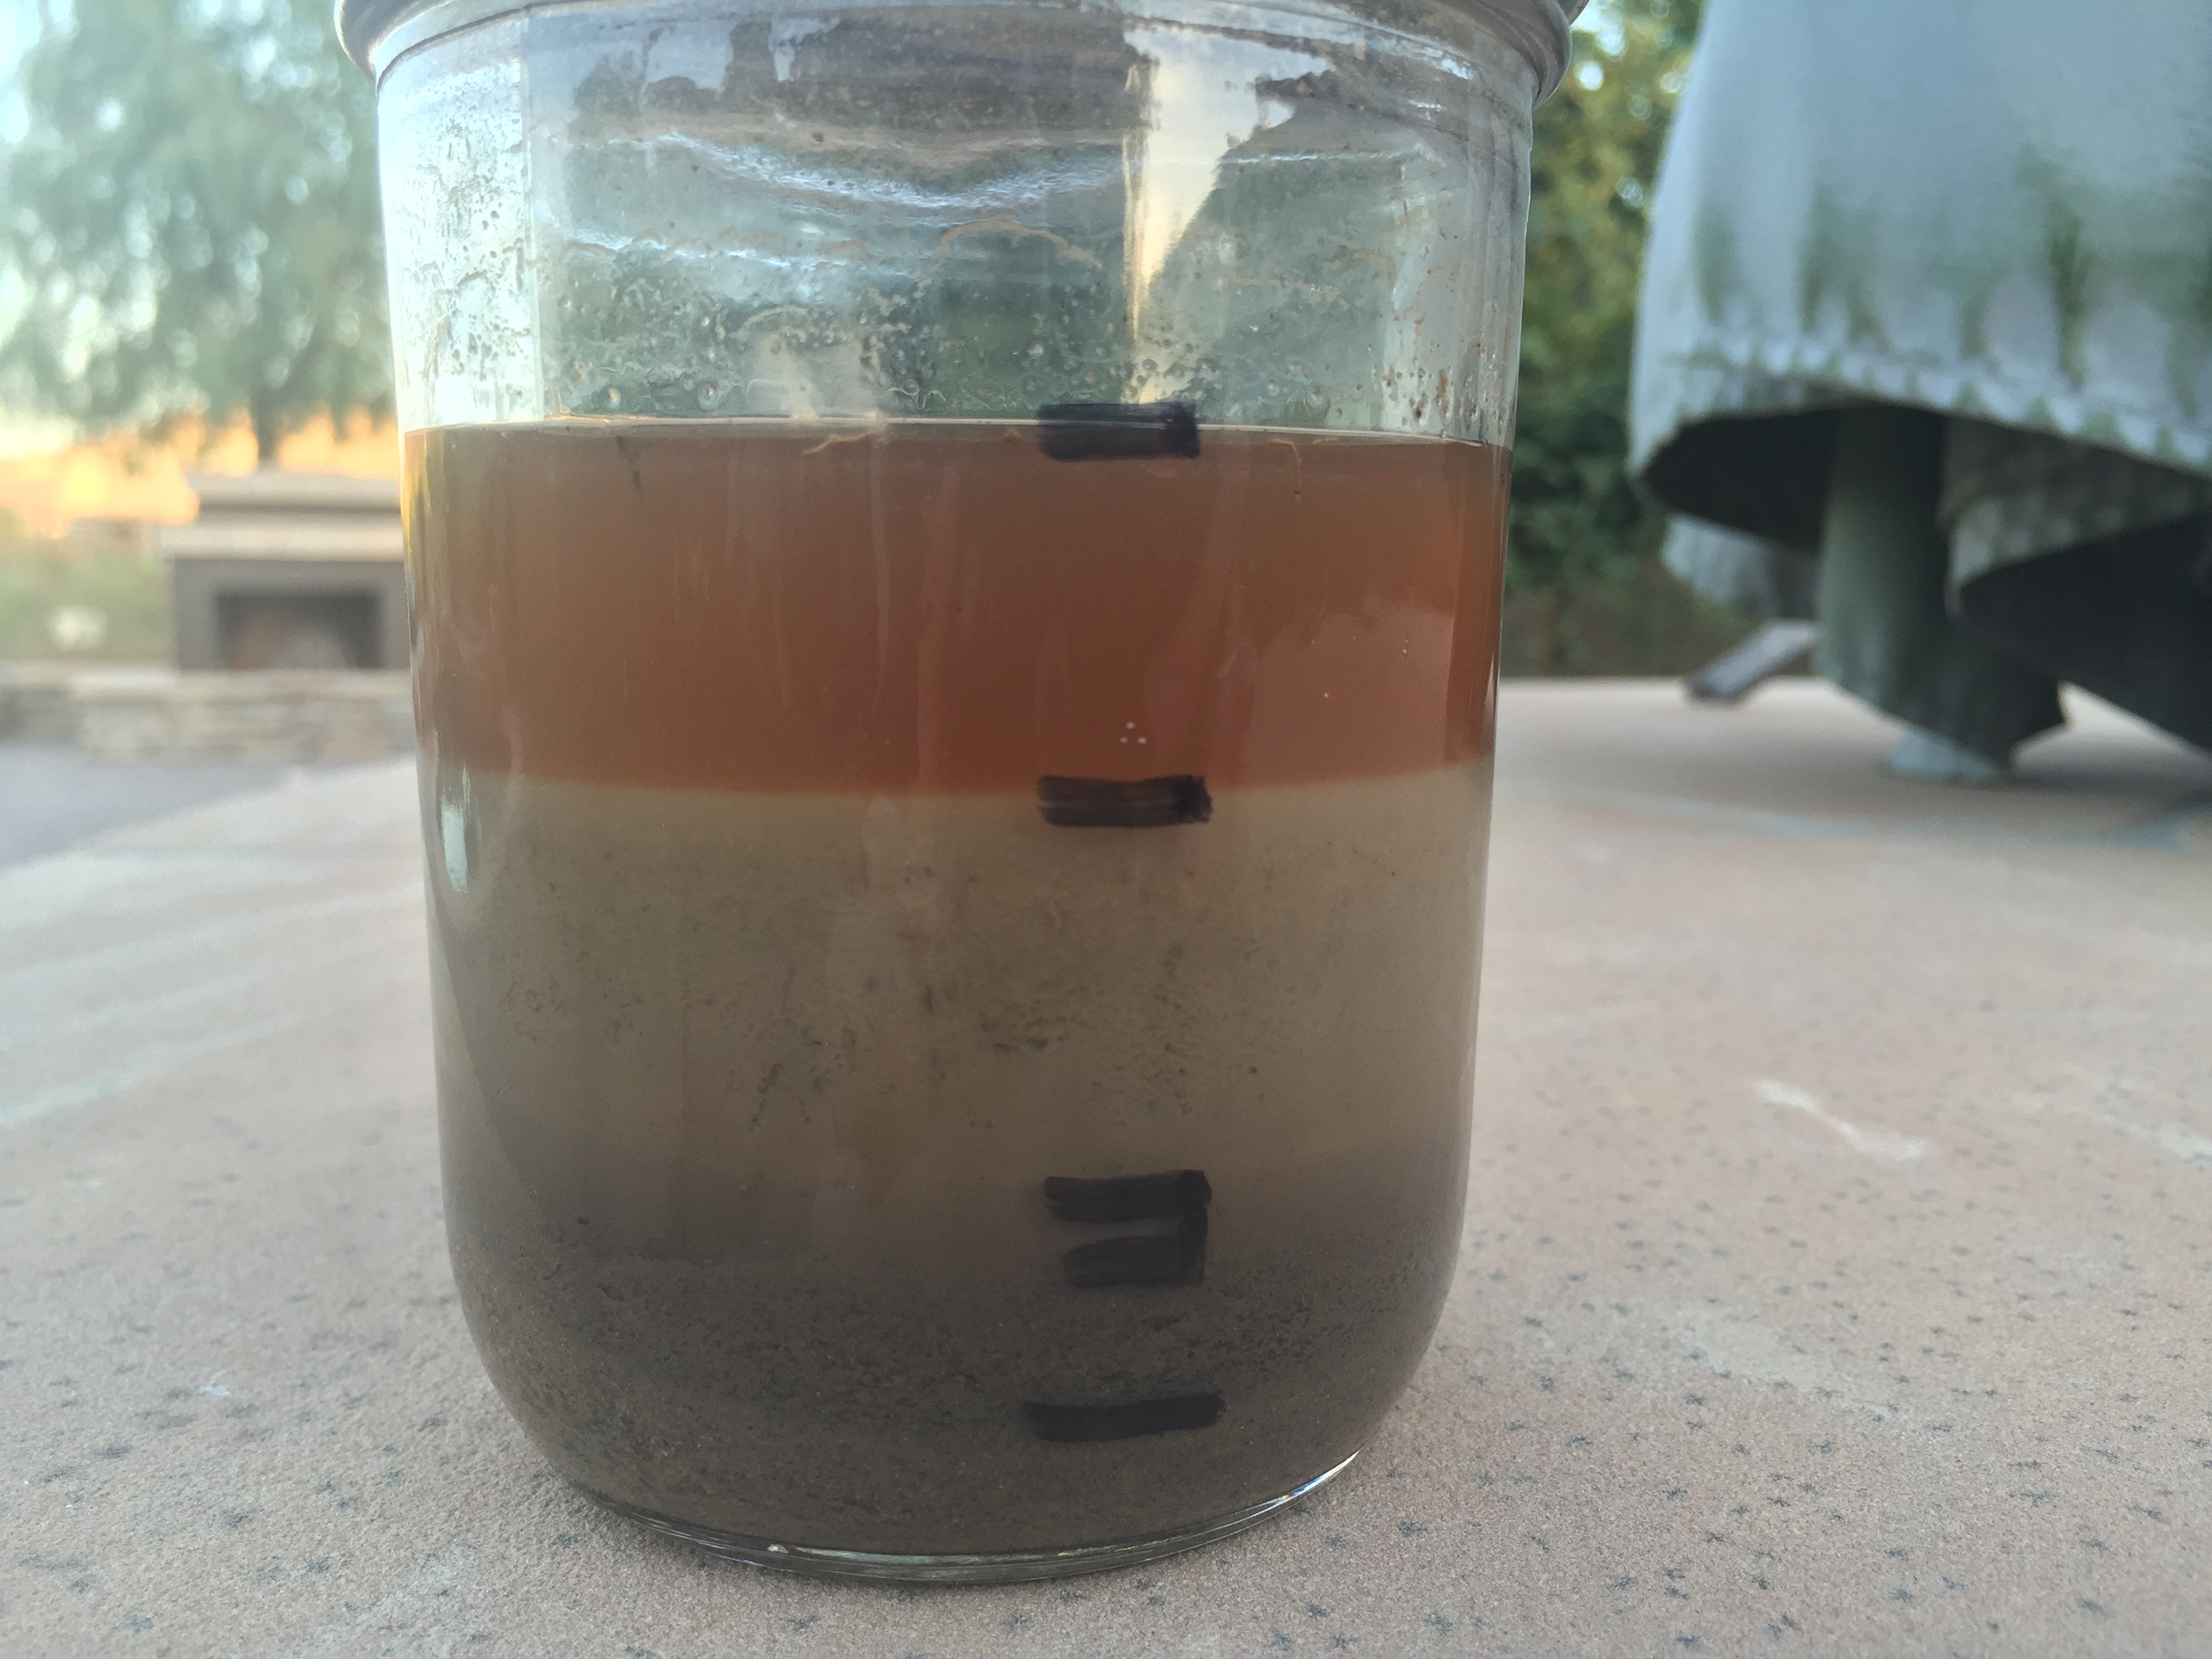
Ribboning isn’t my thing!
Jar Test
1 to 2 cups of soils
Half full of water
Let it set for 2 hours
Measure the height of each layer with a ruler to determine %

Slide 16

Soils 101: Charge
Does soil have a charge?
Sand, silt, clay, and organic matter (negatively charged)
Cations-positively charged ions in the soil
Anions-are negatively charged ions in the soils

Slide 17
Soils 101: Cation Exchange Capacity
CEC (Cation Exchange Capacity)
The higher the CEC the more cations can be held!
High CEC soils resist change
Less fertilization required in general!
When change needs to occur can be difficult!
Color can be an indicator of CEC

Slide 18
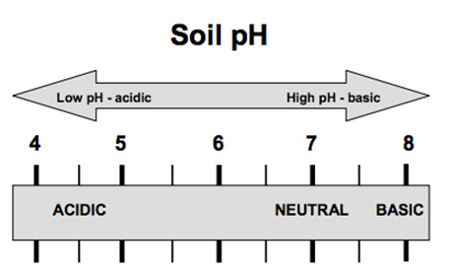
Soils 101: CEC and pH
pH, measure of hydrogen ions (positive charge)
More hydrogen ions the more acidic
Less hydrogen ions the more basic
Higher CEC harder to change pH

Slide 19

Soils 101: Low CEC vs. High CEC
Low CEC soils-typically less water holding capacity, nutrient holding, low organic matter, and high sand
High CEC soils-typically high water holding, high nutrient, high organic matter, and high clay
Drainage

Slide 20
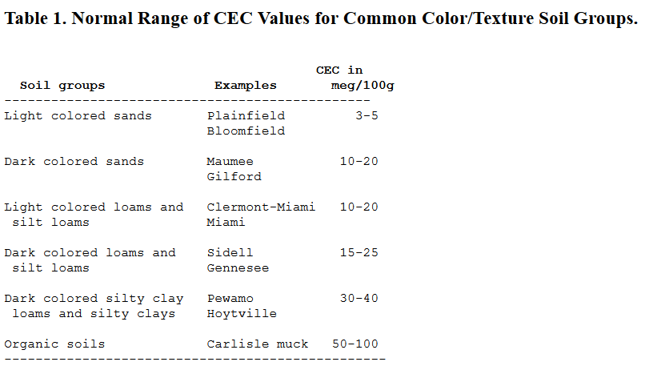
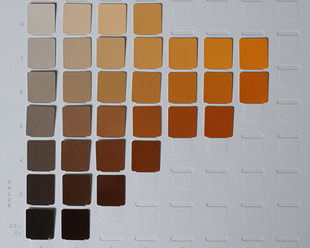
Soils 101: CEC and Color

Slide 21
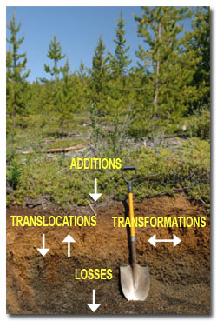
Soils 101: Change
Additions, losses, translocations, and transformations
Clay movement and soluble nutrients
Decaying plants, cover crops, water, fertilizer
Organic matter to humus and weathering
Soluble Nutrients, erosion, water

Slide 22
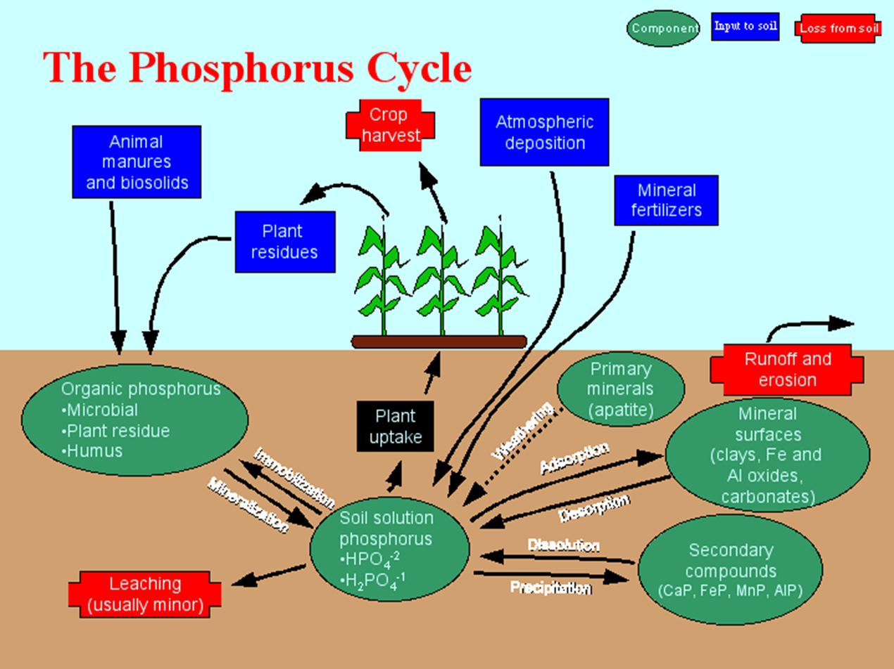

Slide 23
Soils 101: Identify the Change
Returning my grass clippings after mowing
Years of applying compost and manure to my soil
Rain carrying soil off my flower beds
Nutrients moving through the soil profile
Nitrogen changing from mobile to immobile
Additions
Losses
Translocations
Transformations

Slide 24
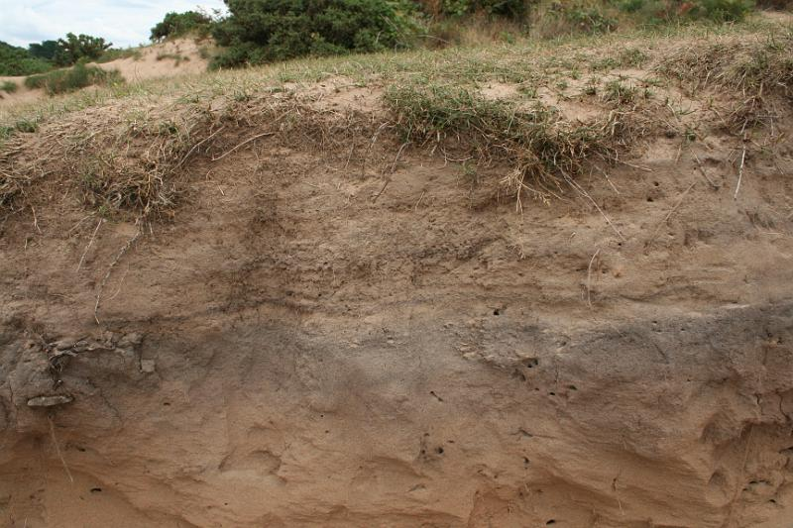
Remember…
Clay, Sand, and Silt
Multiple Horizons
Soil has a negative charge
Soils are dynamic and changing

Slide 25
Soil and Water

Slide 26
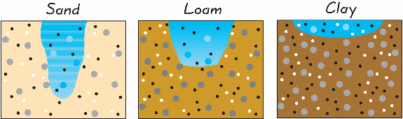
Soil and Water: How Water Moves
Loss

Slide 27
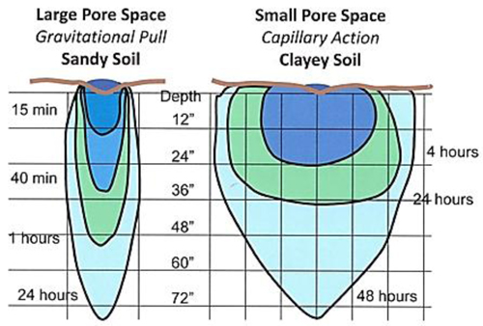
Soil and Water: Irrigation and Texture
When irrigating we need to remember that sand will need more water over time and clay (heavy soils) can do without.

Slide 28
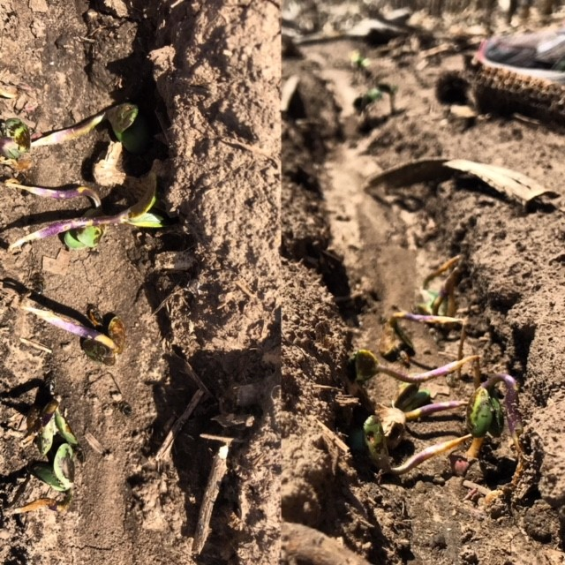
Soil and Water: How Water Moves
Coverage vs. No-Coverage

Slide 29
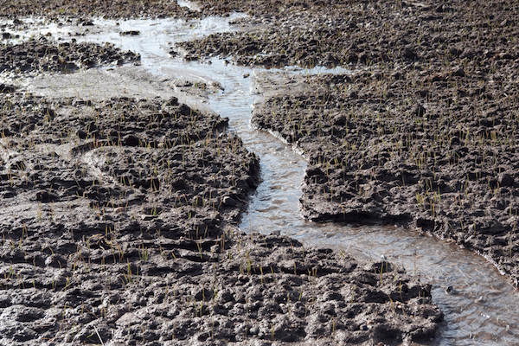
Soil and Water: Erosion
Residue, residue, residue!!!!

Slide 30
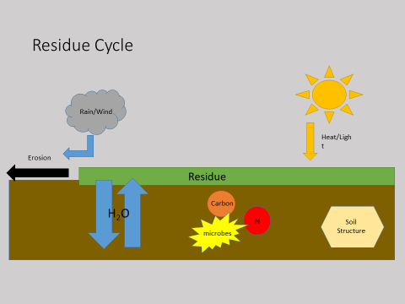
Soil and Water: Residue in Action

Slide 31
Soil and Water: Pros and Cons
Erosion control
Carbon
Soil fertility
Soil structure
Moisture control
Weed control
Soil borne pathogens
In consistent seed bed
Reduced microbial activity
Reduced soil temperatures
Herbicide

Slide 32
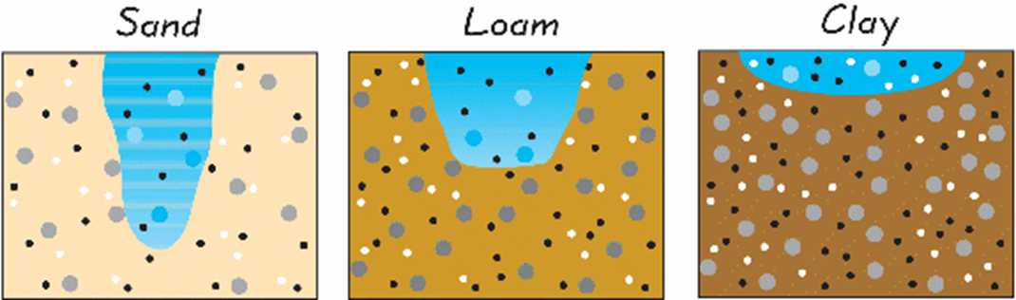
Soil and Water: Texture and Water
How does this relate to drainage of soils?

Slide 33
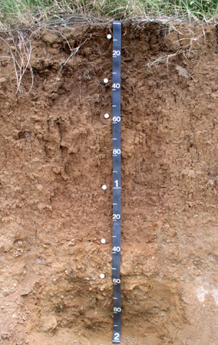
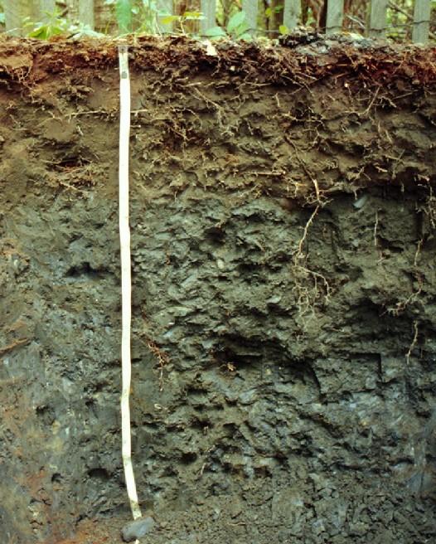
Soil and Water: Drainage
Key identifying words are gleying, gray, or very dark
Brown and bright are key identifiers

Slide 34


Soil and Water: CEC and Soils

Slide 35

Soil Science Investigation
There are clues set up throughout the office, there are four stations that you have to determine the soil problem. Good luck and find the culprit!
Soil Science Investigation

Slide 36
Soil Science Investigation
1) Texture (predominately clay)
2) Jar Test (predominately sand)
3) CEC (high organic matter)
4) Sand highest infiltration rate and clay highest water retention rate
Soil Science Investigation

Slide 37
Soil and Water
Pore size is key
Not all soil mixes are created equal (pot/planters)
Water holding capacity vs. water movement
Residue and conservation

Slide 38
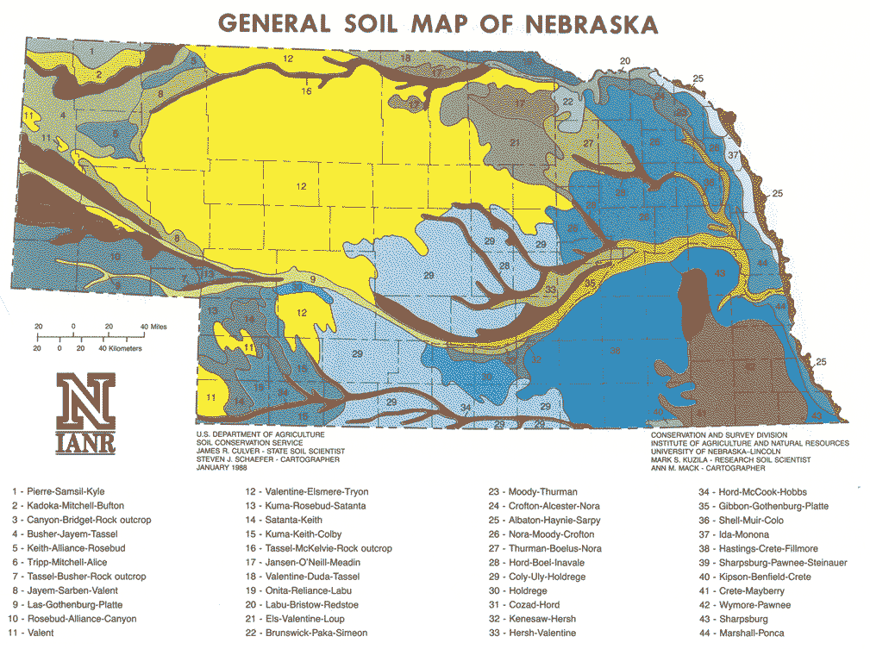
Nebraska soils at a glance
Mesic (moderate water status)
Mollisols, Entisols, and Alfisols (order)
Well drained to excessively well drained
Glacial till, outwash, and alluvium (parent material)

Slide 39
Break Time
Have a piece of soil!

Slide 40

Explore your soils!
https://websoilsurvey.sc.egov.usda.gov/App/HomePage.htm

Slide 41
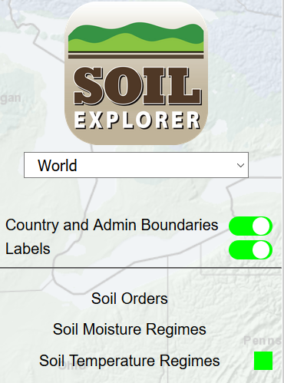
Explore your soils!
https://soilexplorer.net/

Slide 42
Soil Sampling Boot camp
Late summer to Fall is best time for sampling
Soil probe or shovel
Plastic bucket
Sandy soils (2 to 3 years sample)
Clay or Loam soils (4 years sample)
Obvious issues or nutrient deficiency (sample immediately)
More samples more accuracy (12 sub-samples if possible)
Dry samples on newspaper

Slide 43
Sampling Schemes
Area of use
Soil color
Soil texture
Previous crop/treatment

Slide 44
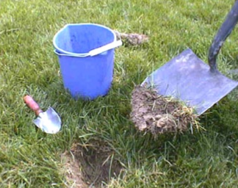
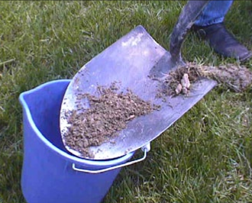
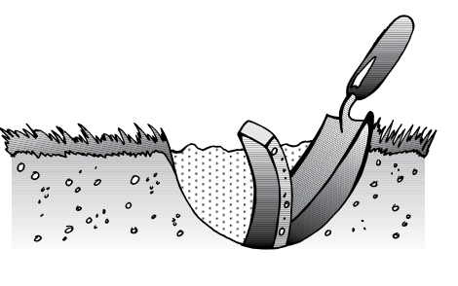
Taking the sample
Remove mulch, rocks, and excess plant material if possible!

Slide 45
Soil Sampling: Vegetable, Small Fruit, and Home Gardens
6 to 8 inches for soil sample (or tillage depth)
Remove surface debris before sampling

Slide 46
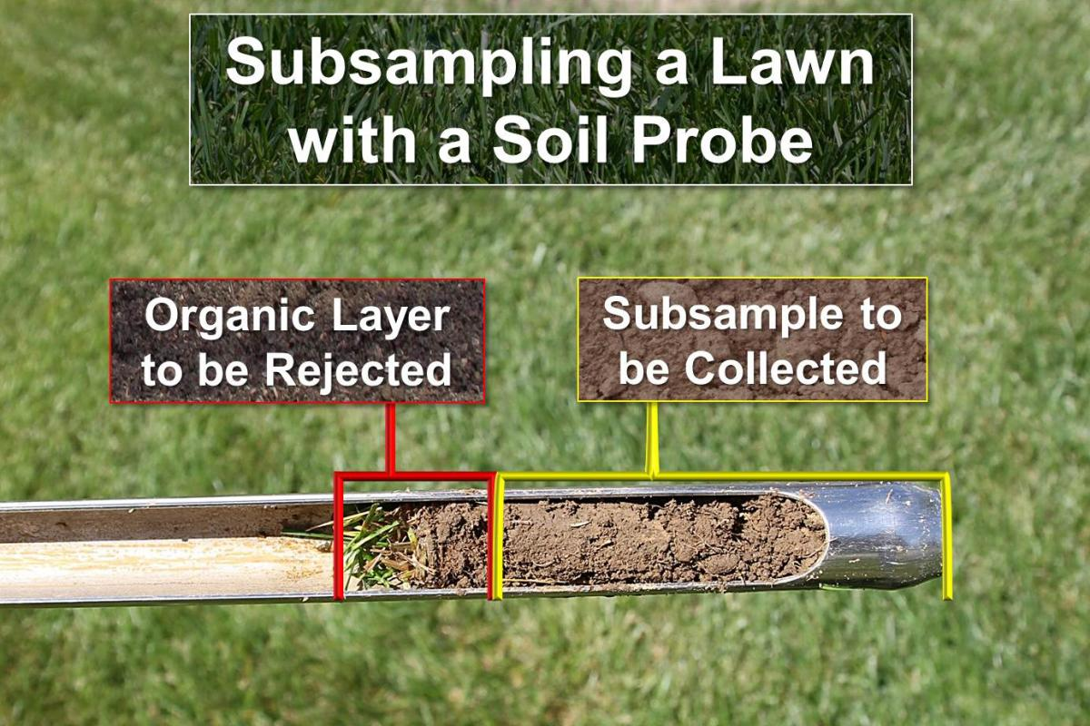
Soil Sampling: Turf
2 to 4 inches for sampling
Remove grass and thatch layer

Slide 47
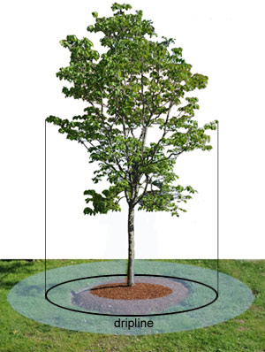
Soil Sampling: Orchard
6 to 8 inches for sampling along the drip line of the canopy

Slide 48
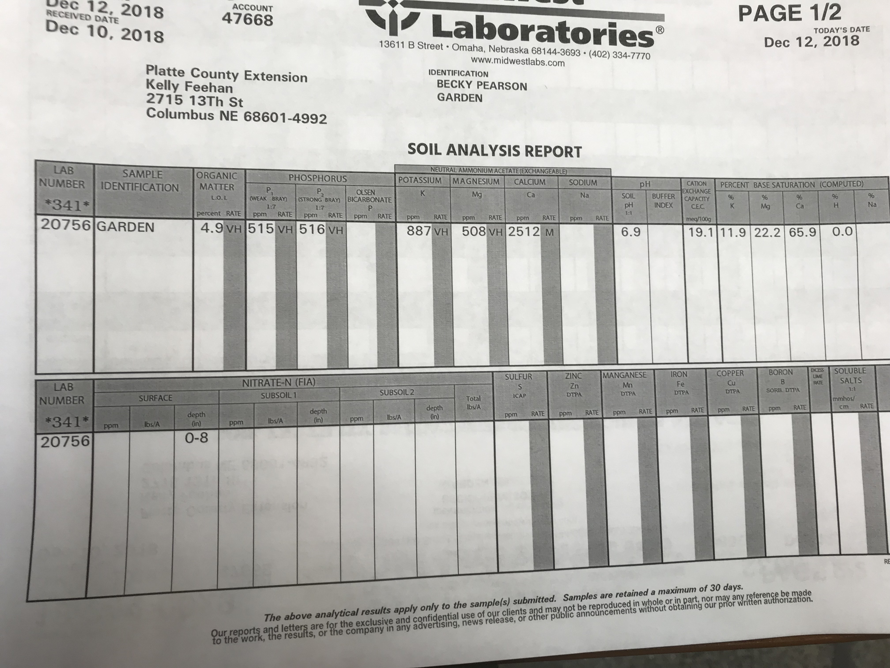
Soil Analysis Report
5
Weak Bray: 20 to 30 ppm
Strong Bray:
40 to 60 ppm
5.5-7.5
Potassium for light colored soils 150-175 ppm dark colored soils 175-250 ppm
http://agrienergy.net/docs/lab-information/interpreting-your-soil-test.pdf

Slide 49
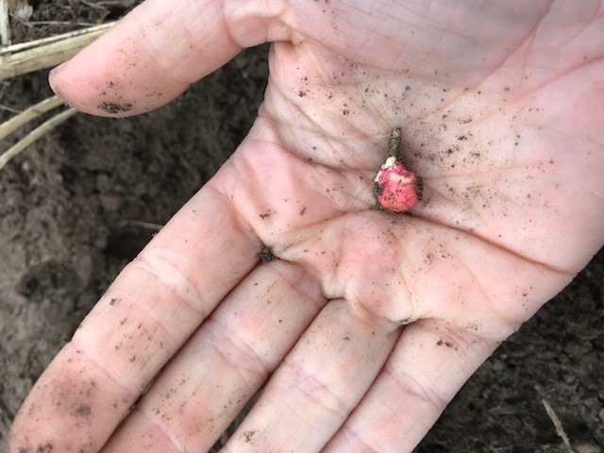
Other Nutrients
Calcium- Less than 400 ppm
Magnesium- Less than 30 ppm
Sulfur- Less than 10 ppm
Manganese- Less than 40 ppm
Copper- Less than 1.0 ppm
Zinc- Less than 2.0 ppm

Slide 50
Conversion: That Recommendation Looks to High
Recommendation: 3600 lbs per acre of CaCO₂
3600 lbs/ 1 acre * 1acre/ 43,560 per square feet
3600 lbs/ 43,560 per square feet
=.0826 lbs per square feet
You have a 1,000 sq foot garden, so multiply .0826(1,000)= 82.6 lbs
*the same applies for lbs of nitrogen per acre

Slide 51
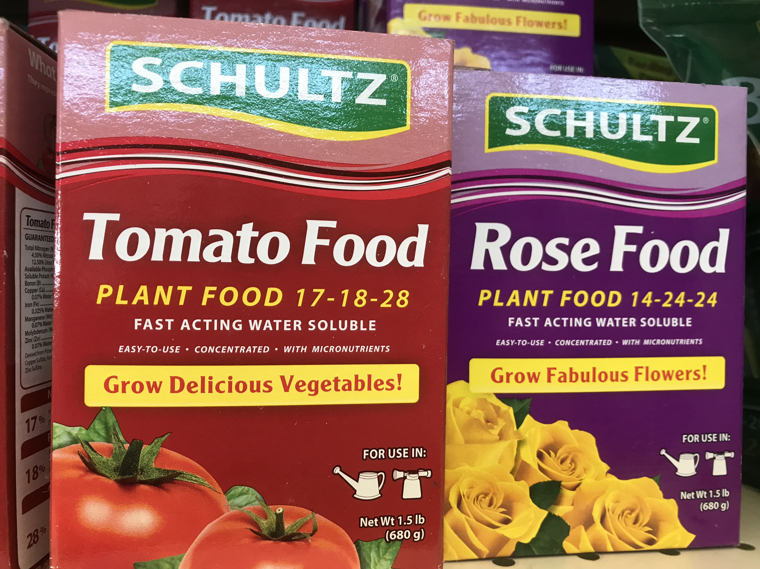
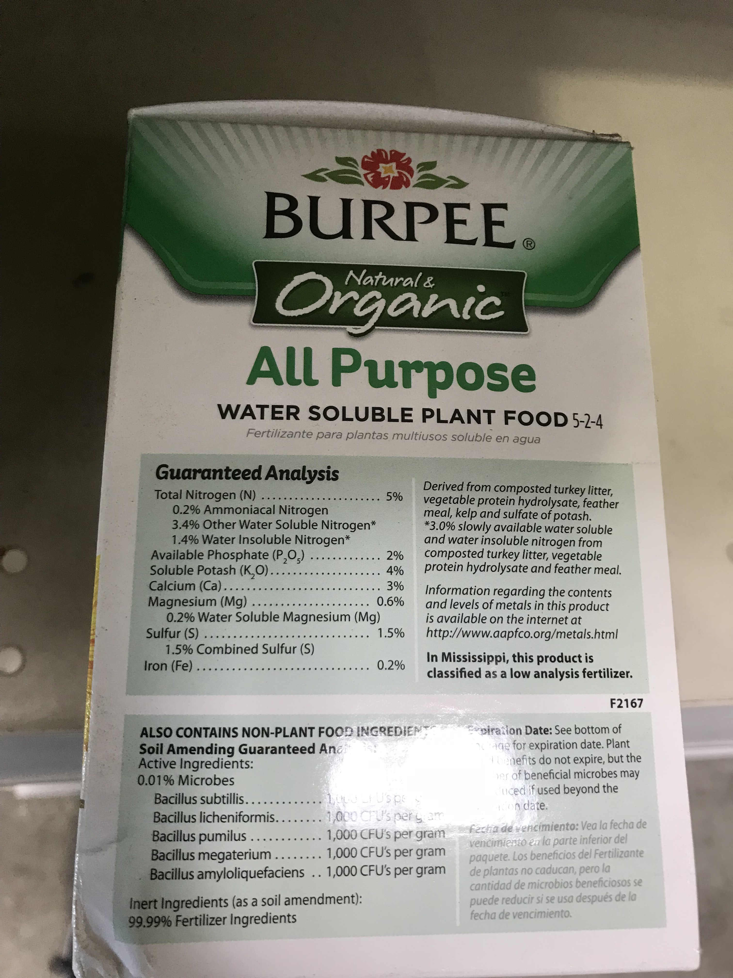
Determining the right product

Slide 52
Total Amount of Nutrients
Remember if we have a 100lb bag of fertilizer with the analysis 12-12-12 then we have…
100lbs*.12=12 lbs of N
100lbs*.12=12 lbs of P₂O₅
100lbs*.12=12 lbs of K₂O
Analysis percent*weight of product=total lbs of nutrient

Slide 53
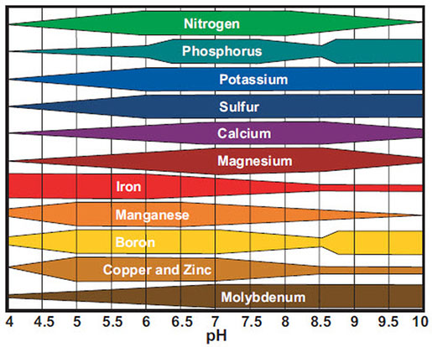
Soil Fertility: pH and availability

Slide 54
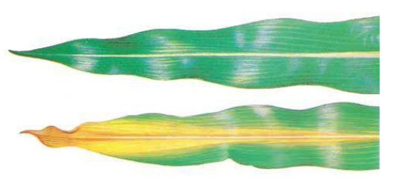
Soil Fertility
Macro nutrients
Nitrogen, Phosphorus, Potassium, Magnesium, Calcium, Sulfur, Hydrogen, Oxygen, and Carbon
Micro Nutrients
Iron, Manganese, Boron, Molybdenum, Copper, Zinc, Chlorine, Nickel, Cobalt, Sodium, and Silicon

Slide 55
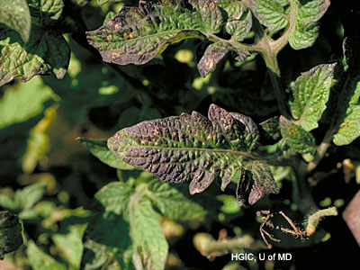
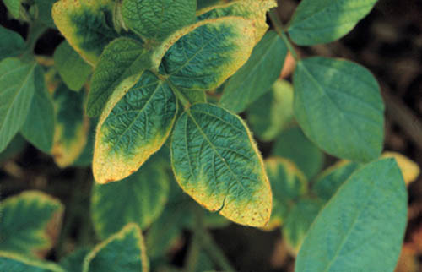
Common Deficiency Symptoms
Phosphorus
Potassium

Slide 56
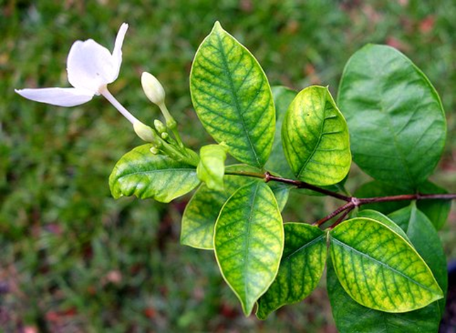

Check soil test to be sure…
Iron
Manganese

Slide 57
Cover Crops and Soil Health

Slide 58
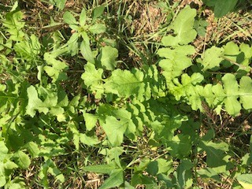
Cover Crops
Typically annual crop
Planted fall, spring, or mid-summer
Acts as living mulch/green manure
Legumes, grasses, and root crops

Slide 59
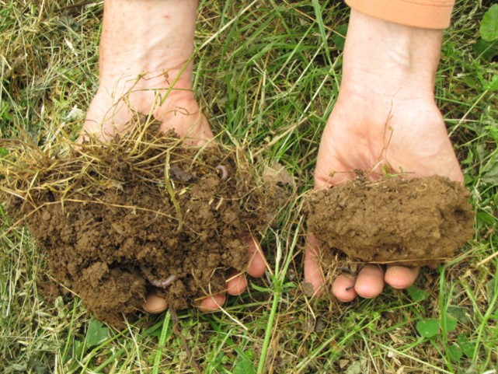
Build Organic Matter and Soil Structure

Slide 60
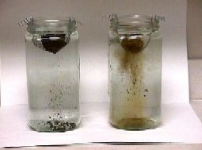
Aggregate Stability
Liu, 2005 (increased aggregate stability with grass cover crops)
Dependent on texture of soil (higher silt contents will break faster)

Slide 61
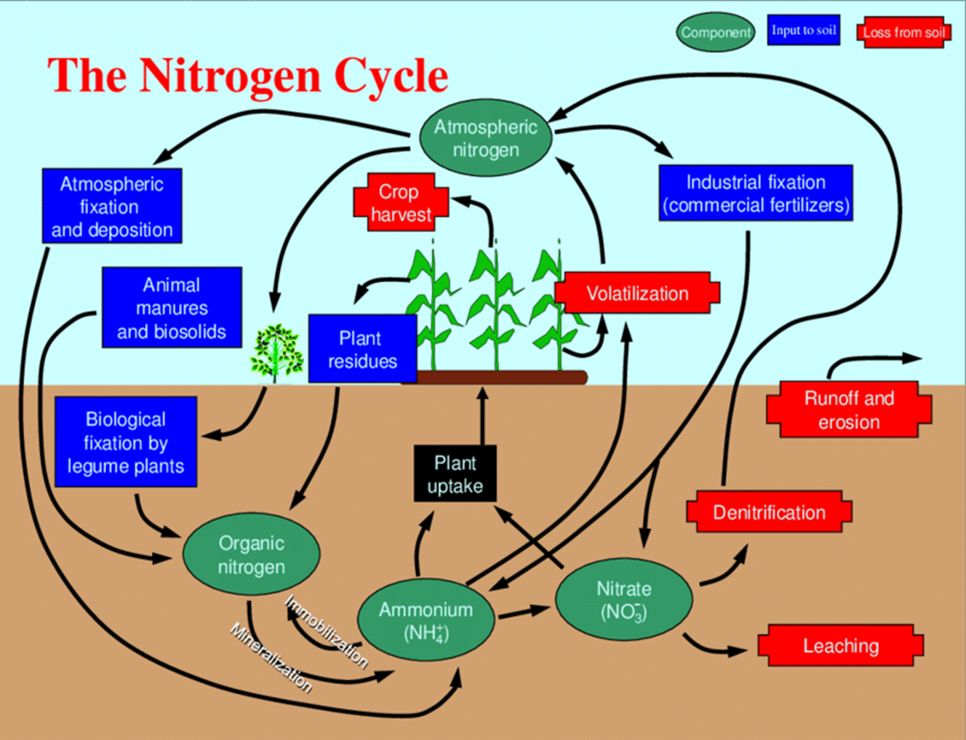
Nitrogen and Soil Health

Slide 62
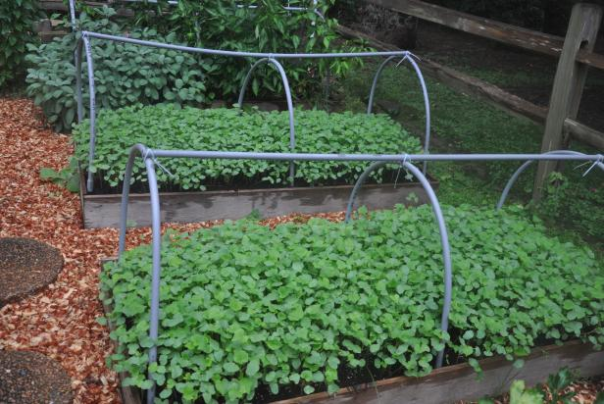
When and Where?
Open soil areas that have little to no cover
Areas prone to flooding
Areas prone to wind or water erosion
Late summer and early fall are best time to plant

Slide 63
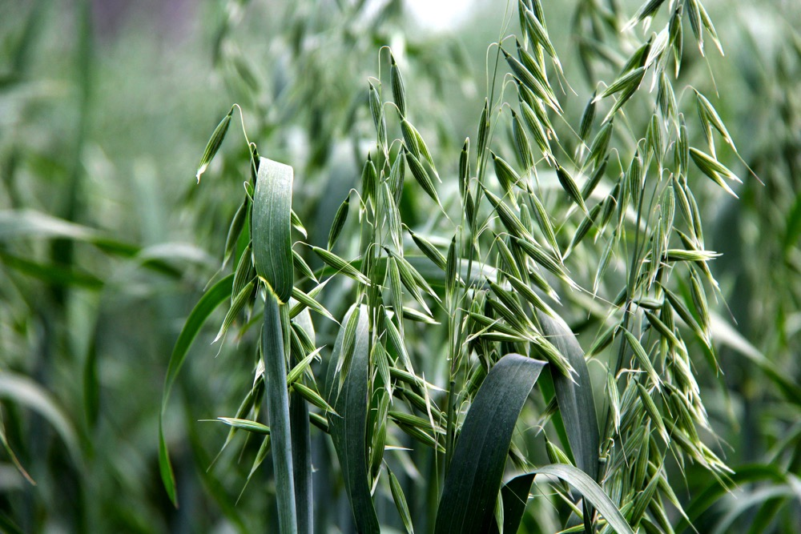
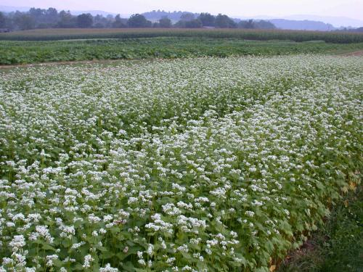
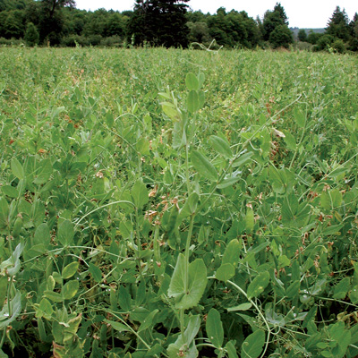
What types should I use?
Annual ryegrass
Buckwheat (Recommend)
Oats (Recommend)
Clover mixes
Peas (other legumes) (Recommend)
Hairy vetch

Slide 64
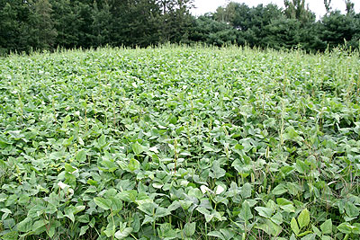
Benefits
Erosion control
Weed suppression
Improved organic matter
Improved fertilization
Soil structure
Water holding capacity
Higher CEC

Slide 65
What’s next and more resources
Start small and work up from there
Research each cover for winter kill and alleopathy
Experiment on your acreage or garden to see the best fit
Chose an easy species to work with
Spring growing cover crops can tie up Nitrogen
University of Minnesota (Garden and Cover Crop)
Penn State University (Cover Crops for Gardens)

Slide 66
Crop Science Investigation
There are clues set up throughout the office, there are four stations that you have to determine the soil and plant fertility problem. Good luck and find the culprit!
Crop Science Investigation

Slide 67
Crop Science Investigation
1) Only 1 bag
2) P, K, and Mg
3) 12 sub samples per area if possible
4) The hill, ridge, and garden if possible; various options
Crop Science Investigation

Slide 68
Question 1
What is CEC?
A) Cation exchange capacity
B) Corrected evapotranspiration calculation
C) Calculated electrical charge
D) Clowns executing cartwheels!

Slide 69
Question 2
How many sub-samples of soil should I take for my garden?
A) 4 sub-samples
B) 20 sub-samples
C) 12 sub-samples
D) 15 sub-samples

Slide 70
Question 3
Soil ribboning tells me what about the soil?
A) The soil order
B) The soil texture
C) The CEC
D) The parent material

Slide 71
Question 4
Rate the soils for water holding capacity from best to worst.
A) sandy, clay, and silty
B) silty, clay, and sandy
C) clay, silty, and sandy
D) silty, sandy, and clay

Slide 72
Question 5
What is one way I can stop erosion at my home?
A) apply mulch to loose areas
B) nothing erosion will happen regardless
C) plant grass, a perennial, or cover crop
D) plant an annual on severe slopes
E) All but B

